Slide 1
Introduction to Windows
Krisha Pahwa

Slide 2

What is Windows?
operating system
competition on Windows 10
Windows server (2019)
not as user-friendly
contains server software
more RAM and processing cores
more secure

Slide 3
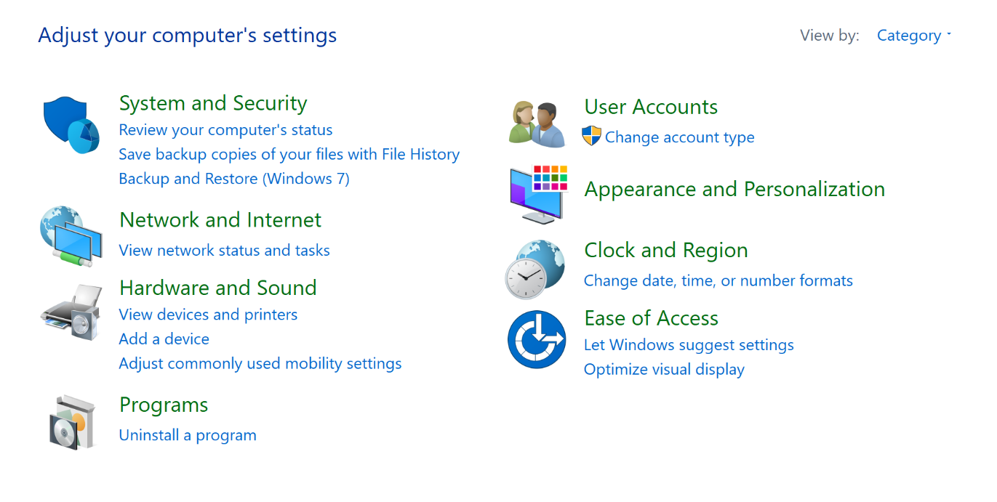
Control Panel
central hub for most of your tools
access: taskbar ⇒ Windows symbol/search bar ⇒ type control panel ⇒ select

Slide 4
Users
Types: Administrator vs. Standard
Administrator ⇒ full access + control
Standard ⇒ limited/restricted access
not allowed to mess with system files
cannot install new programs
Password recommendations
8 characters
mix of numbers, letters (uppercase and lowercase), and special characters

Slide 5
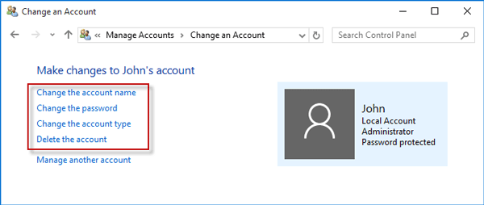
User Accounts
Adding
Deleting
Changing account type
Change Password

Slide 6
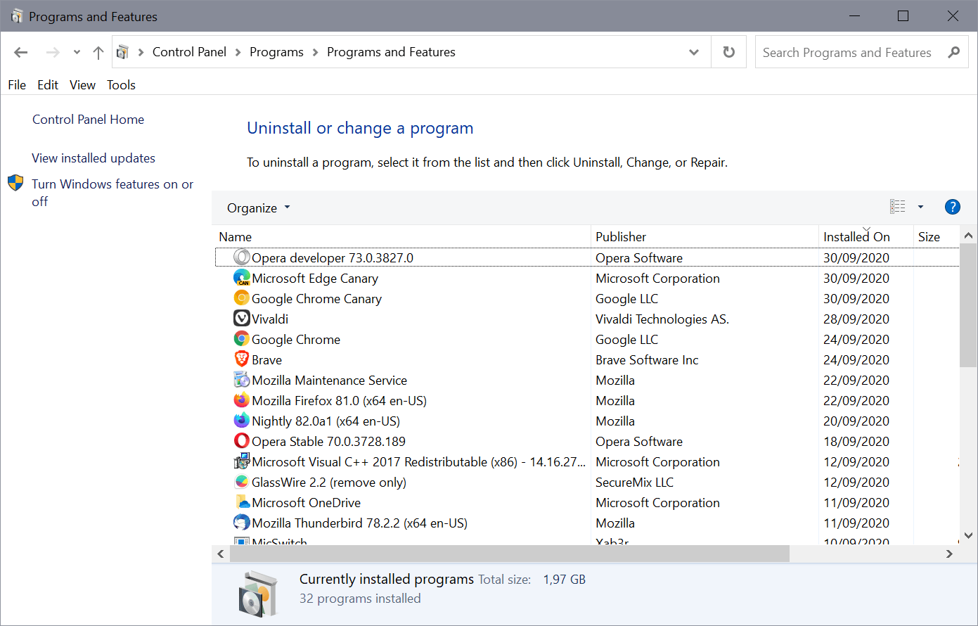
Programs
delete unwanted programs

Slide 7
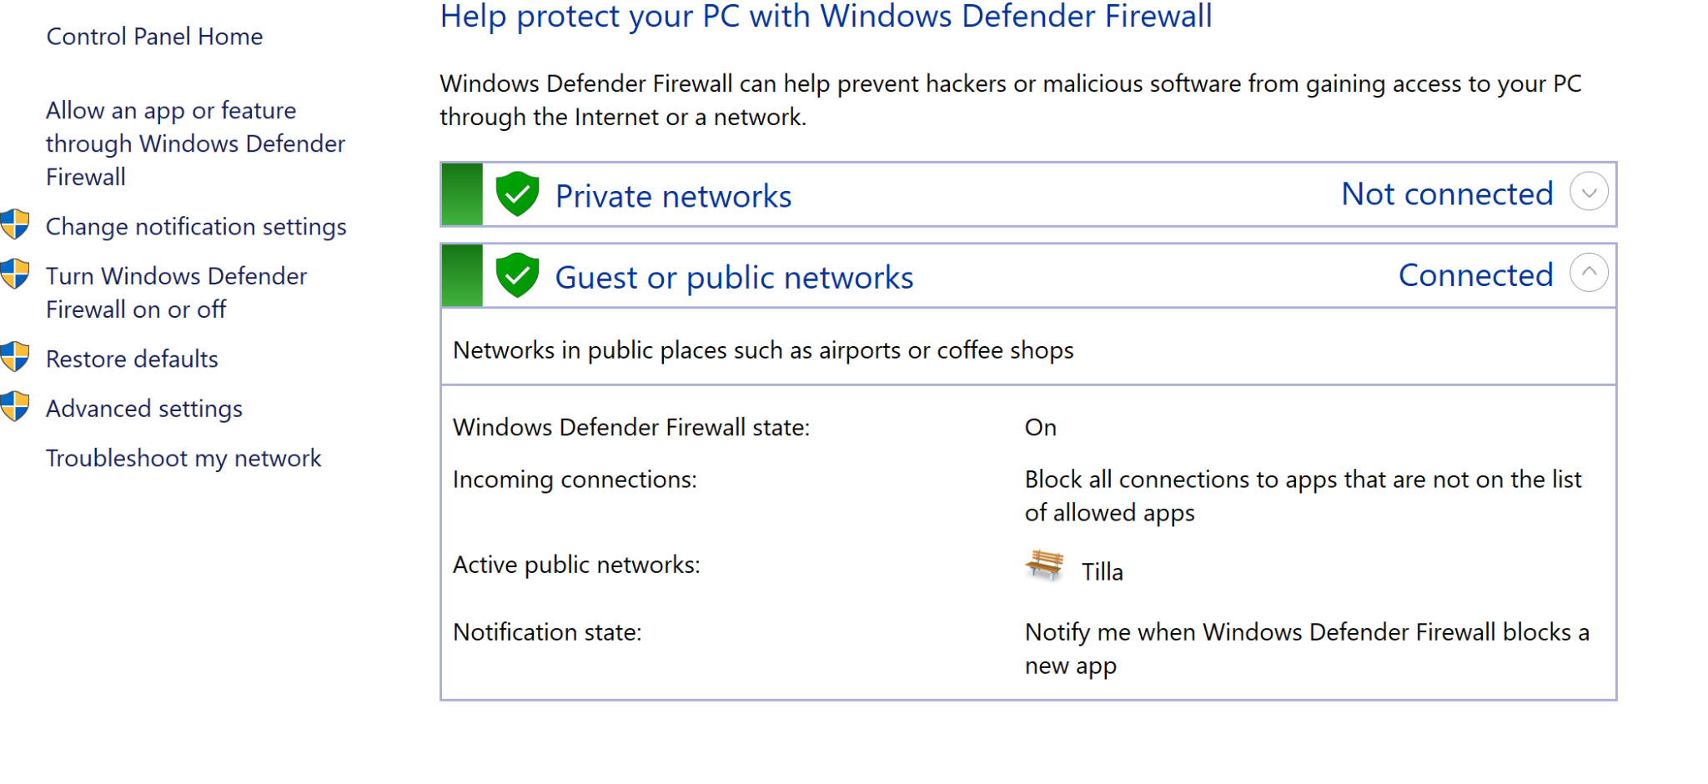
Firewall
firewall (in general) ⇒ protection to make sure that your outgoing and incoming signals are safe
always check to see if it's on
for more in-depth, go to advanced settings

Slide 8
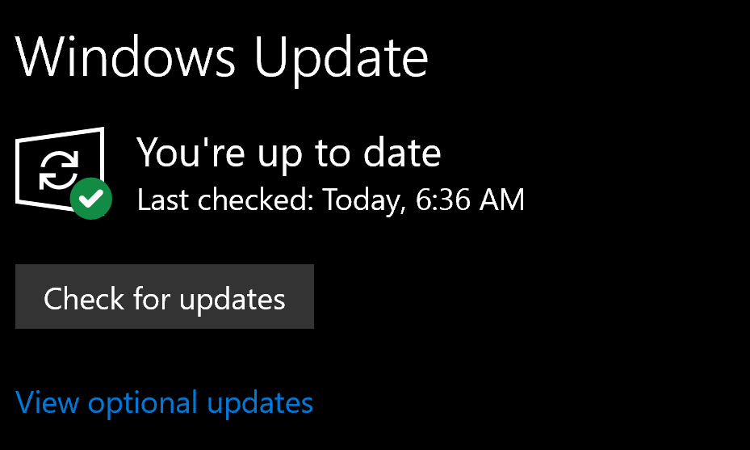
Updates
always have notifications on
always run daily updates
access: settings ⇒ windows updates ⇒ check for updates

Slide 9
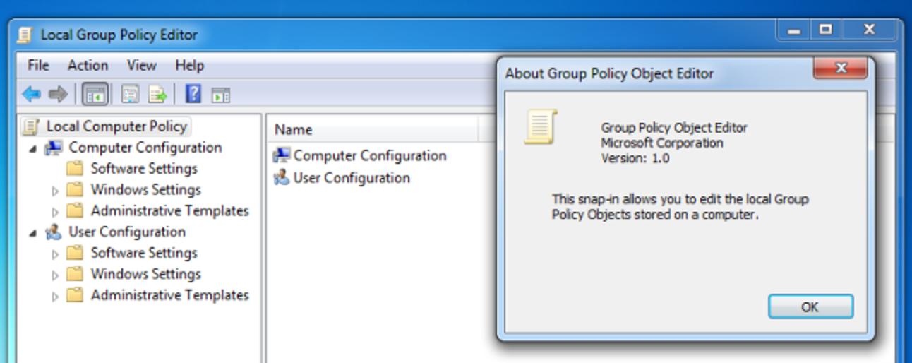
Group Policy
view groups:
taskbar ⇒ computer management
windows + r ⇒ lusrmgr.msc
access:
control panel ⇒ system and security ⇒ local group policy
windows + r ⇒ gpedit.msc

Slide 10
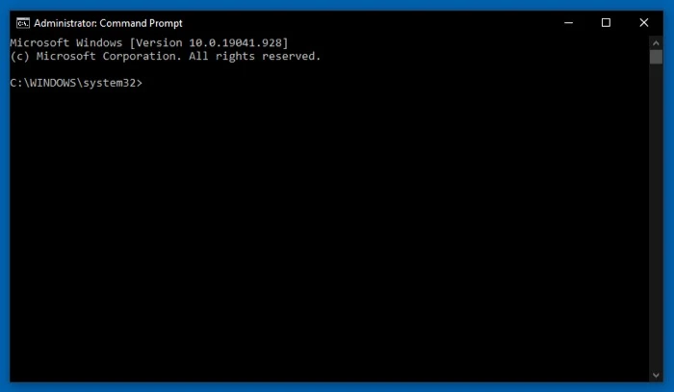
Command Prompt
access:
windows + r ⇒ cmd
taskbar ⇒ search command prompt
command line interface; interacts directly with the computer

Slide 11
Commands
netstat ⇒ list of all active TCP or UDP connections
Protocol, local port IP address, foreign port IP address, connection state
systeminfo ⇒ info about your machine
tasklist ⇒ task manager, but on command prompt

